Slide 1
Text Indexing
By,
Nanditha S Murthy

Slide 2
Abstract
Introduction
Flowchart
Algorithm
Advantages and Disadvantages
Challenges
Further Improvements
References
Conclusion

Slide 3
Introduction
This project is about text indexing, a method to collect, parse and store data for fast and efficient ways of retrieving/searching information
Helps in finding required words within one or more text files and thus serves as a search query through a database.
Index data structure:
Stores a list of occurrence of the words in the form of hashtable.

Slide 4
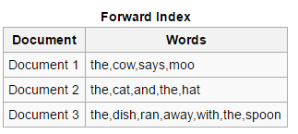
Index inverted/ merging:
This architecture supports incremental indexing, where a merge identifies the documents to be added or updated and then parse each document into words.
After parsing, the indexer adds the referenced documents to the document list for the appropriate words.
Th eprocess of finding words in the inverted index is relatively time consuming for a large search engine. So the development is split into two parts:
Forward index

Slide 5
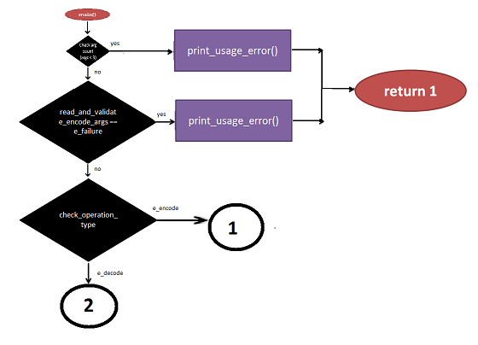
Flowchart
main()

Slide 6
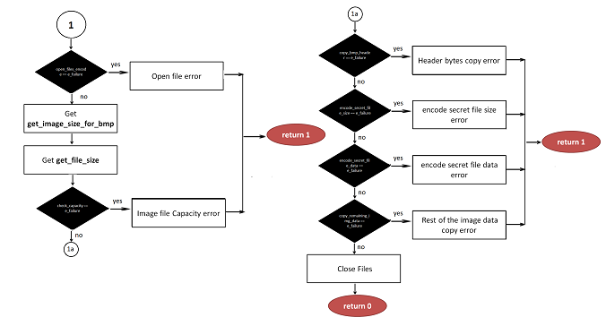
Flowchart – cont..
main()…{ e_encode}

Slide 7
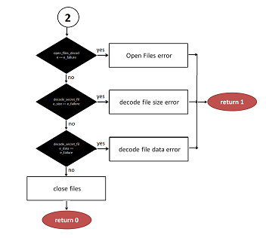
Flowchart – cont..
main()…{ e_decode}

Slide 8
Algorithm

Slide 9
Algorithm- cont…

Slide 10
Algorithm- cont…

Slide 11
Algorithm- cont…

Slide 12
Algorithm- cont…

Slide 13
Algorithm- cont…

Slide 14
Algorithm- cont…

Slide 15
Algorithm- cont…

Slide 16
Algorithm- cont…

Slide 17
Advantages and Disadvantages
Many applications[1]
: search engines
: biotechnology – Hiding message in DNA sequence
Forward index: as documents are parsed, it is better to immediately store the words per document
The forward index is sorted to transform it to an inverted index.
Converting the forward index to an inverted index is only a matter of sorting the pairs by the words.
Space requirement is large for larger database.
Search is time consuming for a large database

Slide 18
Challenges
Search: inverted indexing and forward index conversion to find the data in a short interval of time
Index size: how much words and files the search engine can support
Lookup speed: how quickly a word can be found in the inverted index. i.e the speed of finding an entry in the data structure, as compared with how quickly it can be updated or removed.

Slide 19
Further Improvements
Indexing wrt frequency helps in ranking relevance of the documents to the query and more. Such topics are the central research focus of information retrieval.
Proposed methods on dynamic inverted indexes for distributed systems, web search engines, and others provide a good scope for research and further improvements.

Slide 20
Conclusion
Proposed text Indexing is a good proposal for small data search engine. Helps in retrieval of information like searching for a word from a set of documents.

Slide 21
References
1. https://en.wikipedia.org/wiki/Search_engine_indexing

